Slide 1

Agile Coaching and DevOps Enablement Project Azure Boards Training
Session 1 - Fundamentals
06/28/21

Slide 2
Agenda
Overview
Azure DevOps Boards
Teams, Processes, Tools
Walkthrough: Team Tools & Settings
Work Items
Work Item Types
Walkthrough: Create Work Items
Boards & Backlogs
Walkthrough: Working with Backlogs
Walkthrough: Sprint Taskboards
Collaboration
Team Dashboards & Wikis
Walkthrough: Creating Wiki Content

Slide 3

My Background – Saul Dolgin
I have been helping organizations unlock technology value for more than 25 years. Most recently I am focused on cloud infrastructure & DevOps processes with a tilt towards enabling "everything as code." Prior to launching on my consulting journey, I had been a software developer, release manager, enterprise architect, and IT director among other titles. My passion for all things Microsoft Azure have led me to earn 4x certification status with my goal being to never stop learning.
I have been writing code since early childhood, when the first family PC (an IBM PC 286) was brought into the home. I started out by hacking up public domain floppies from a local bookstore and have never looked back since then. I am grateful to have had known from those early days exactly what I wanted to build my career on... helping business do more with software.
Certifications
AZ-400: Azure DevOps Engineer Expert
AZ-500: Azure Security Engineer Associate
AZ-204: Azure Developer Associate
AZ-104: Azure Administrator Associate
Experience – Highlights
Interests
Azure Infrastructure & DevOps Consultant
IT Director, Architecture & Design
Enterprise Architect
Release Manager
Software Developer
My wife & kids
Snorkeling
Beach sand
Cycling / e-bikes
Learning & helping others learn
Skills
Coaching & Training
Team Leadership
Azure DevOps
Agile Methodologies
Software Architecture
Infrastructure as Code
Data Center Migration

Slide 4
Getting Started – What is Azure DevOps?
DevOps definition
The union of people, process, and technology to continually provide value to customers.
Azure DevOps
Azure DevOps provides services for teams to plan work, collaborate on code development, and build and deploy applications. Azure DevOps supports a culture and set of processes that bring developers and project managers and contributors together to complete software development. It allows organizations to create and improve products at a faster pace than they can with traditional software development approaches.
Azure DevOps is the technology part in the union of people, processes and technology.

Slide 5
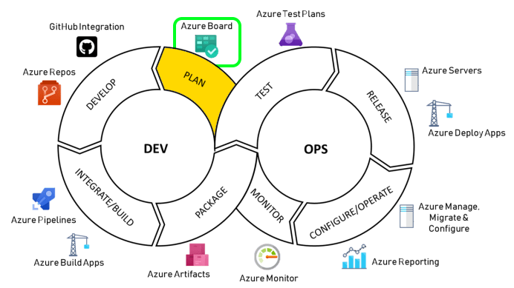
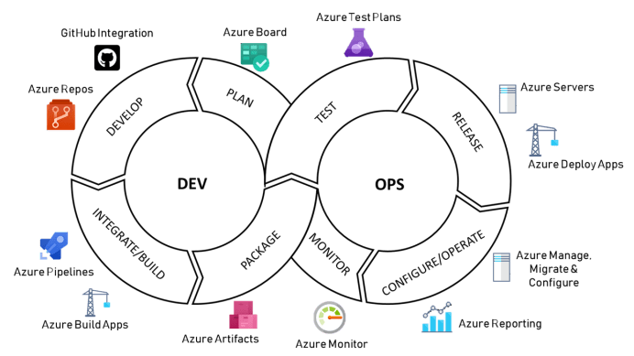
Azure DevOps Services
Azure Repos – source code
Azure Pipelines – build & release
Azure Boards – planning & tracking
Azure Test Plans – testing tools
Azure Artifacts – package management
In combination these services provide full coverage of the “Dev” processes in DevOps

Slide 6
Azure Boards in a slide…
“Unofficial” Definition
A set of web-based tools for tracking a hierarchy of work items surfaced through dashboards, backlogs views and board views.
4 Processes to start from…
Basic Epics, Issues & Tasks
Agile Epics, Features, User Stories, Tasks, Bugs, Issues
Scrum Epics, Features, Product Backlog Items, Tasks, Bugs, Impediments
CMMI Epics, Features, Requirements, Tasks, Bugs, Change Requests, Issues, Reviews, Risks
Processes above can be customized and extended to support your team’s needs

Slide 7
Azure Boards – Team Tools
Hierarchy of Teams
Multiple teams defined for apps & shared services (e.g., value streams)
All teams roll-up to the “Default Team” and share a common backlog of work items
Each team gets their own set of customizable tools & views to track work items
Areas & Iterations
Area path & Iteration path are “tree fields” (common to all work item types)
Area path describes which app or service (e.g., value stream) a work item pertains to
Each team “subscribes” to the area paths they want to include in their views
Iteration path used for sprint planning & for displaying the current iteration’s work
Every team controls how their work is displayed using the configuration settings above.

Slide 8
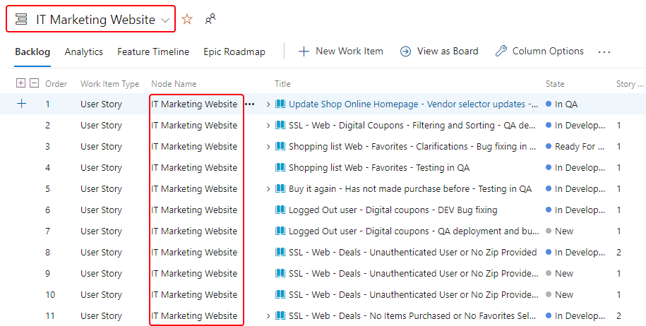
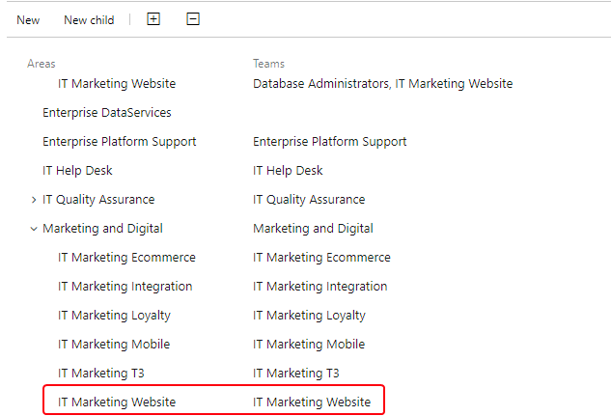
Azure Boards – Area Paths
Assign Areas to Teams
The assignments determine what shows up on the team’s backlog and what work items the team is responsible for.
Azure Boards provides a common backlog. Each team gets their own view but is still able to collaborate.

Slide 9
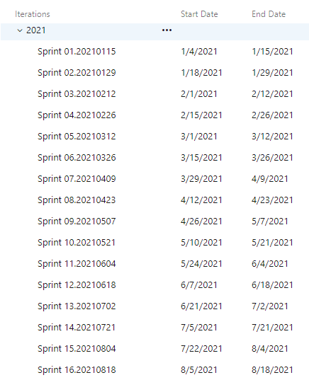
Azure Boards – Iteration Paths
For release planning purposes, use a common calendar / iteration tree for all teams
New work assigned to a default iteration, then mapped to a specific iteration during planning
Sprint Taskboard & Backlog views display work for a single iteration
Current (default), past & future iterations can be reviewed per team
Used properly, iteration paths support release planning & can inform roadmap conversations.

Slide 10
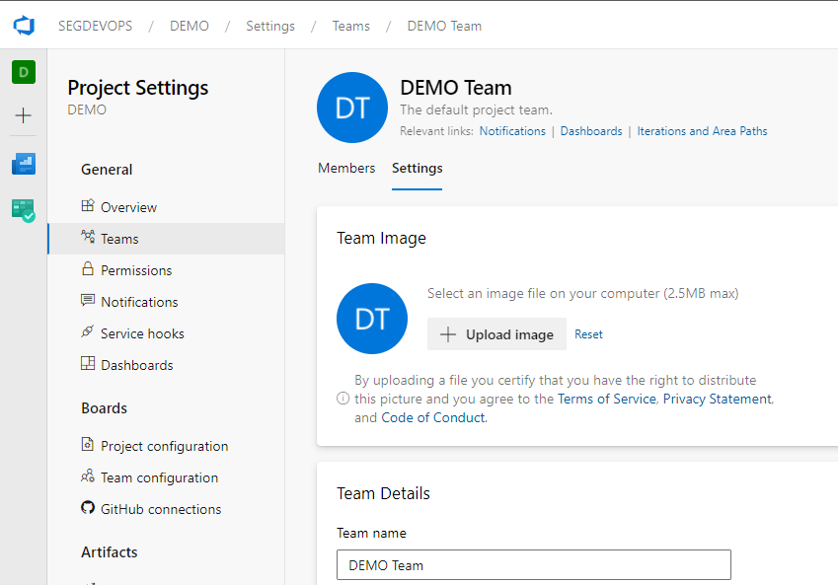
Walkthrough
Team Tools & Settings
Notes:
Introduce Navigation & UI
Left Navigation explanation (hubs)
Top Navigation (bread crumb & team picker)
Top Right Settings
Project Settings (bottom left)
Setup project area paths & iterations
Area paths should reflect the value streams for the organization
Explain benefits of common iteration paths
Configure team area paths & iterations
Discuss how areas & iteration settings affect tools used by each team
Add team members
Does not affect permissions to repos or pipelines
Navigate between teams

Slide 11
Agile Process – Work Item Types (WITs)
Initiative
Task
Group related Epics for portfolio planning
Updated daily during a sprint
Epic
Bug
Assigned to Product Manager & Platform
Tracked as part of the product backlog
Feature
Independently releasable unit of functionality
User Story
Can be completed in a single sprint
Items are associated in a hierarchy for tracking effort from high-level down to implementation work.

Slide 12
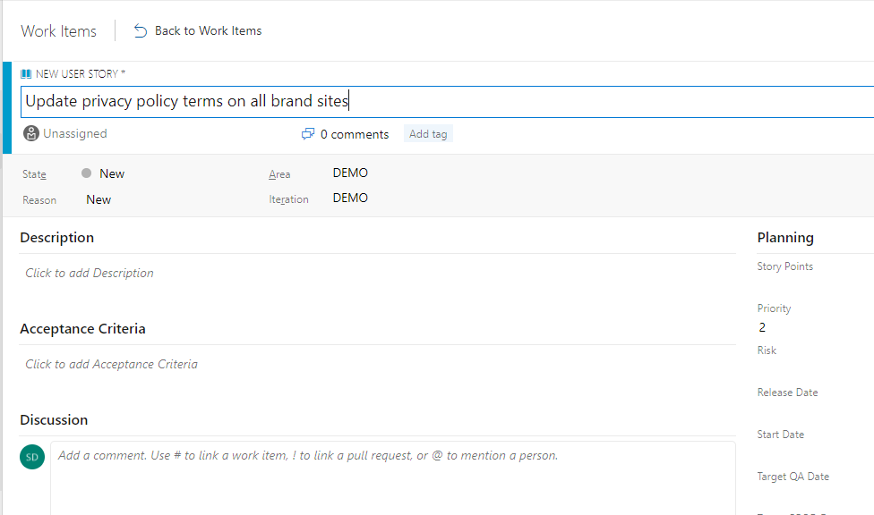
Walkthrough
Creating Work Items
Notes:
1) Create user stories
Save customer rating for product
Display average rating on product details page
2) Create tasks for each story
Review story with BA (1)
Review design with lead (1)
KT and hand-off with QA (1)
Review leads to the following tasks being created
Create database objects for storing customer rating (4)
Modify API services to accept customer rating (4)
Update web UI to display rating input controls (4)
Review area path assignment
Items above should belong to web team

Slide 13
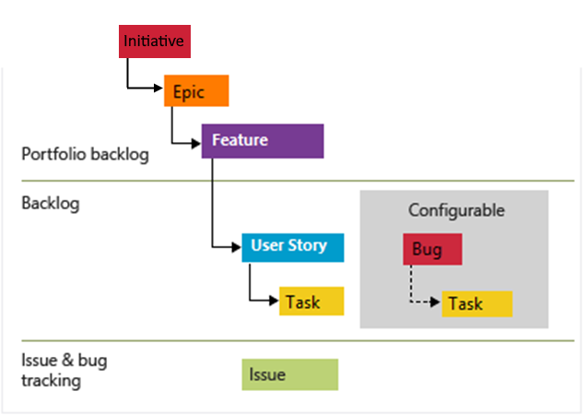
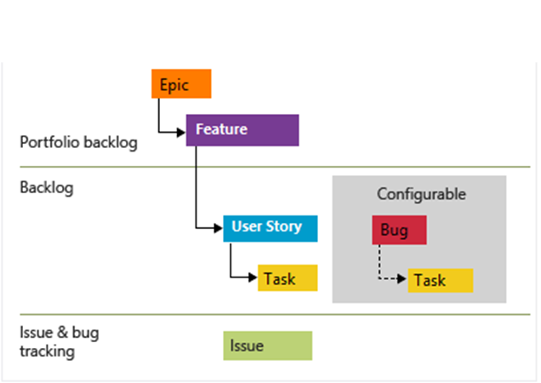
Agile Process - Backlogs
3 types of backlogs:
Portfolio – high-level features or scenarios
Product – prioritized list of user stories
Sprint – items in the current iteration
Hierarchical structure
Customizable per team
Portfolio & product backlogs used for mid to long term planning while Sprint backlog is for the immediate commitments.

Slide 14
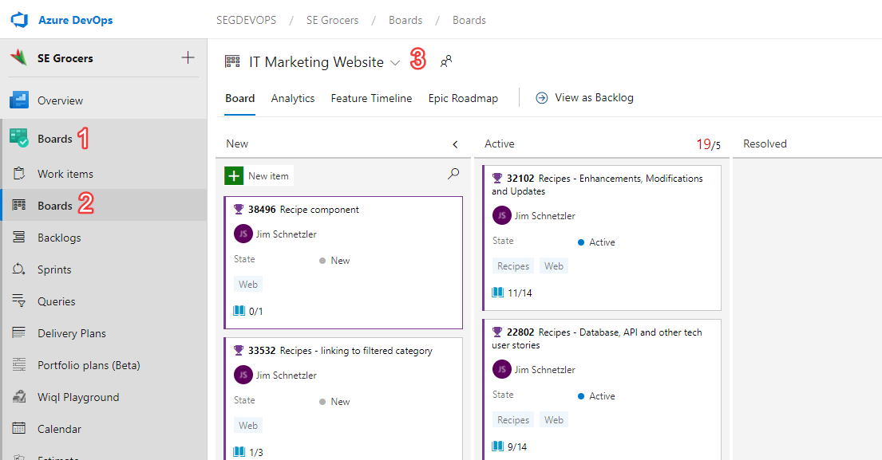
Agile Process - Boards
Interactive (drag-and-drop)
Maps workflow states to board columns
Configurable summary cards
WIP limits for tracking bottlenecks
Live updates automatically refresh
Customizable per team
Kanban boards display backlog items in a visual flow of work

Slide 15
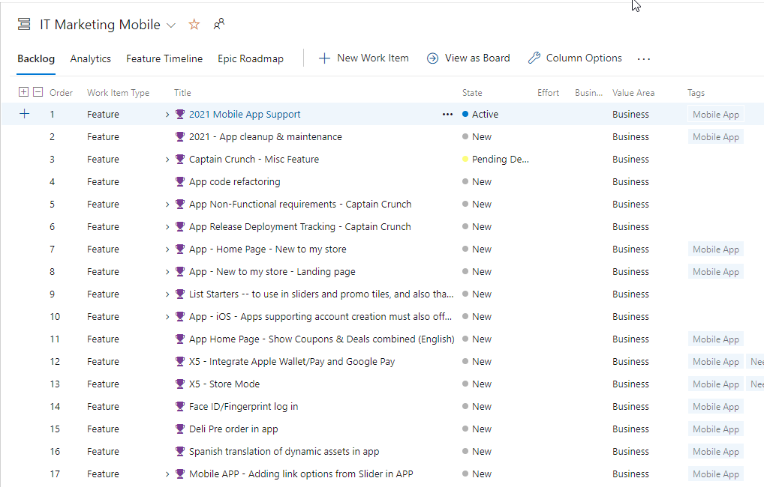
Walkthrough
Working with Backlogs
Notes:
Create Initiative: Transform our customer’s online shopping experience.
Create Epic: Increase customer feedback with new features.
Create Feature: Customers can provide and share ratings for products.
Create link between dependencies (i.e. Data Services team will do the database task for our example user story)
Associate new user stories to the items above…
Display and discuss backlog
- Portfolio team views vs. product team views
Hierarchy focused view
Columns & roll-up columns
Display and discuss Kanban board
State-flow focused view (minimal columns)
WIP limits

Slide 16
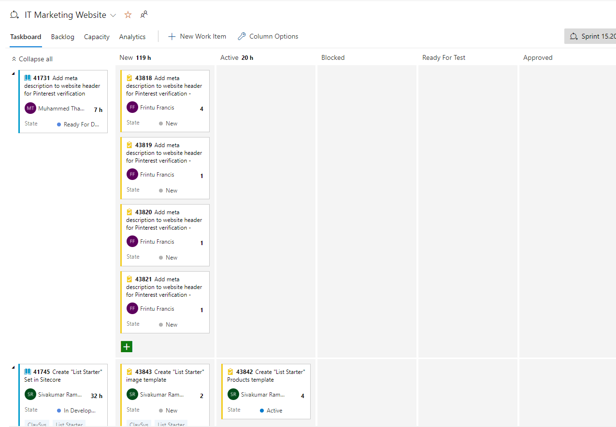
Agile Process – Sprint Taskboard
Primary Focus of the Daily Scrum meetings
Filtered based on current iteration per team
Live update / automatic refresh
Update task status via drag & drop
View & update remaining work
Group by Story or Group by People
This is the view teams huddle around during the daily stand-up. Prepare your task updates in advance.

Slide 17
Walkthrough
Sprint Taskboard
Notes:
Discuss story view (used during stand-up)
Discuss people view (examples of when this might be helpful)

Slide 18
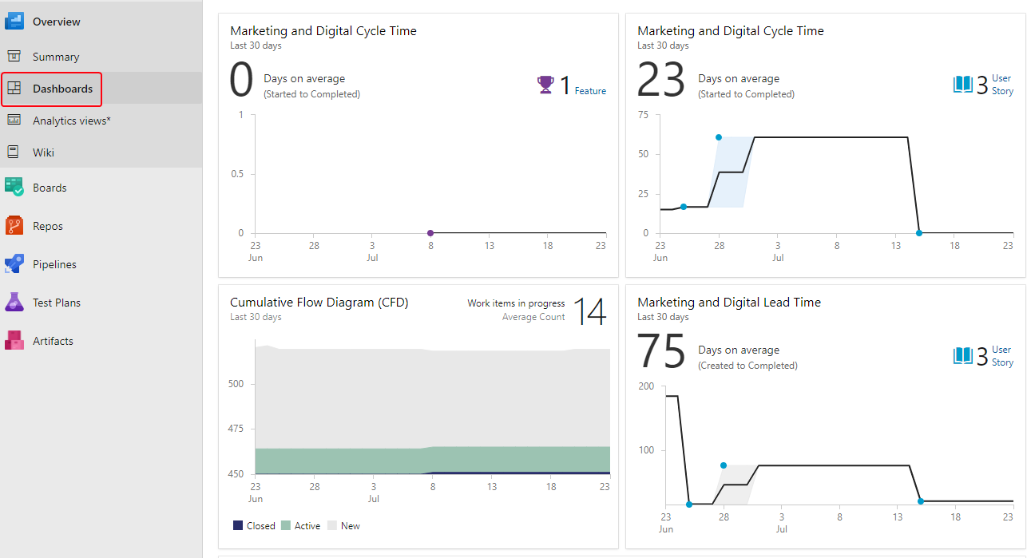
Team Dashboards
Real-time information
Project level for stakeholders & management
Team level for product teams
Catalog of widgets
Boards
Repos
Pipelines
Markdown
Analytics & Historical Data
Dashboards can also help facilitate retrospective conversations by highlighting trends

Slide 19
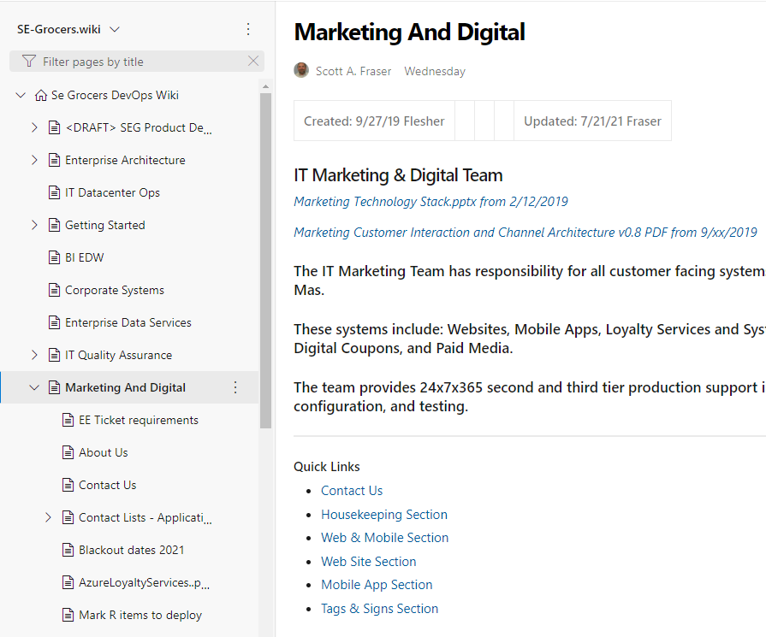
Knowledge Sharing w/ Wiki Content
Markdown for text formatting, images, tables, etc
Collaborative editing of content & structure
Semantic search includes all wiki content
@ Mentions & Work Item linking
English language “word-stemming”
Revision history, diff view & revert changes
Use the wiki to share information with your team to understand and contribute to your projects.

Slide 20
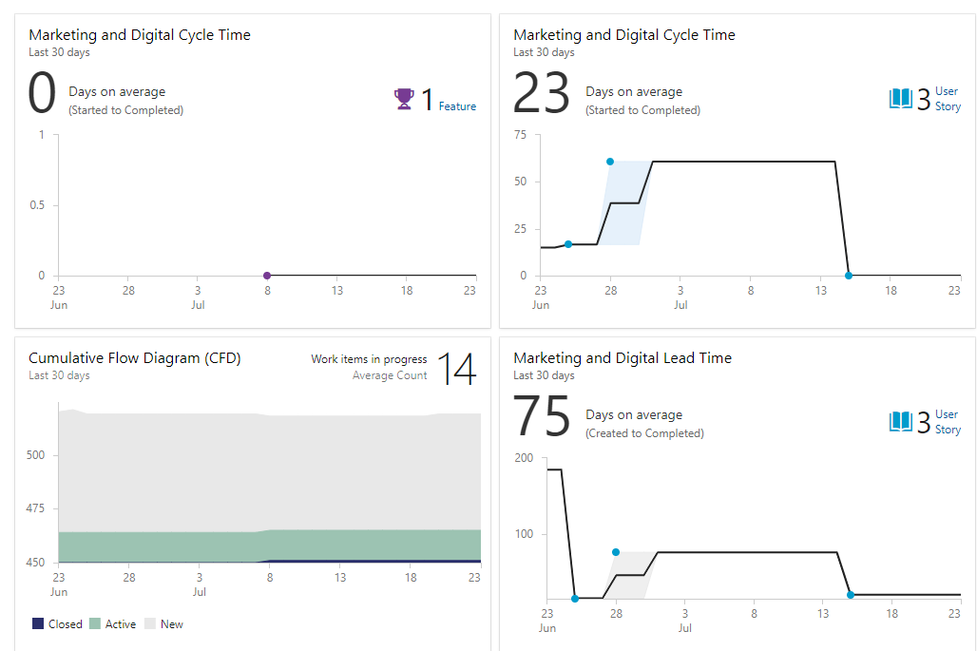
Walkthrough
Dashboards & Wiki
Notes:
Create wiki page for retrospective session
Went well:
Add a few notes
Needs to improve:
Add a few notes
Action items:
Create a user story here with linking
Save multiple times & demonstrate versioning of wiki content
Create a dashboard page that includes marketplace widgets
- Add dashboard widget for markdown & link to work item template
- Demonstrate ability to summarize work status on a dashboard

Slide 21

Questions & Answers
This Photo by Unknown Author is licensed under CC BY-SA

